Slide 1
CAPSTONE PROJECT – 1
EXEL
ENTARTAINMENT PREFERENCES
Done By :
Kiruthik. A

Slide 2
Introduction
This project analyzes entertainment preferences among different age groups and genders. The dataset explores how people engage with various forms of entertainment such as movies, music, and streaming platforms. It also examines factors like monthly entertainment spending, streaming hours, and event attendance, providing a clear picture of consumer behavior and trends in the entertainment industry.

Slide 3
Objective Of The Project
To identify the most popular movie and music genres among different age groups.
To analyze entertainment spending habits across various demographics.
To study streaming platform preferences and usage patterns.
To understand how factors like age and gender influence entertainment choices.
To provide insights that can help entertainment providers better target their audiences.

Slide 4
Tools and Technologies Used
Microsoft Excel – For data cleaning, analysis, and visualization.
Pivot Tables – To summarize and group data efficiently.
Charts (Bar, Pie, Box Plot, Line) – For trend visualization.
Excel Functions – AVERAGE and CORREL for data computation.

Slide 5
Methodology
Data Collection: Survey-based data was collected from 250 participants of various age groups.
Data Cleaning: Removed duplicates, corrected missing values, and categorized users into defined age groups.
Data Analysis: Used Excel formulas AVERAGE and Pivot Tables to summarize and compare patterns.
Visualization: Created bar charts, pie charts, Line chart and box plots to visually represent relationships and trends.
Interpretation: Derived meaningful insights from charts and pivot summaries to support conclusions.

Slide 6
Business Requirements:
Age group And Their Entertainment Behavior

Slide 7
Gender And Their Favorite Movie Genre

Slide 8
Average Monthly Requirement Spent By
Age Group

Slide 9
Descriptive Statistics
Column1 | Streaming_Hours_per_Week | Monthly_Entertainment_Spend | Event_Attendance_per_Year
Mean | 17.78 | 1668.67 | 5.12
median | 18.00 | 1652.00 | 5.00
Mode | 29.00 | 1401.00 | 10.00
Range | 25.00 | 2491.00 | 10.00
Variance | 61.16 | 476691.19 | 11.08
Standard Deviation | 7.82 | 690.43 | 3.33
Q1 | 11.00 | 1078.00 | 2.00
Q3 | 25.00 | 2265.25 | 8.00
IQR | 14.00 | 1187.25 | 6.00
Lower Fence | -10.00 | -702.88 | -7.00
Upper Fence | 12.50 | 1079.50 | 3.50
Correlation | 0.08 | -0.02 | 0.05

Slide 10
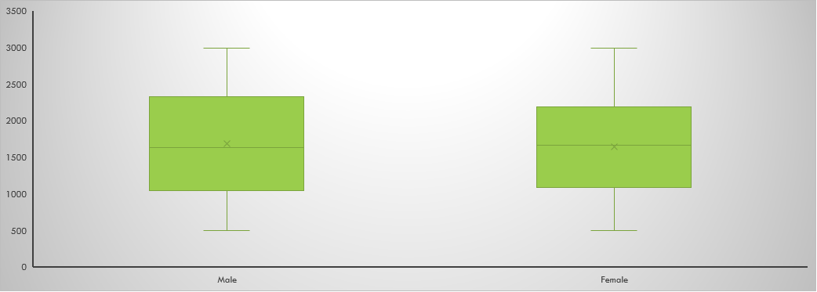
Monthly Entertainment By Gender

Slide 11
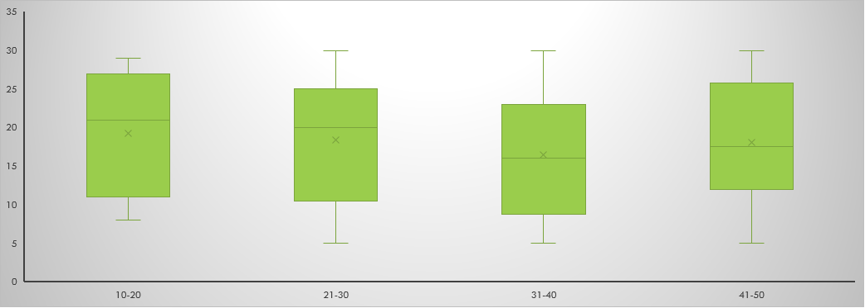
Streaming Hours Per Week By Age Group

Slide 12
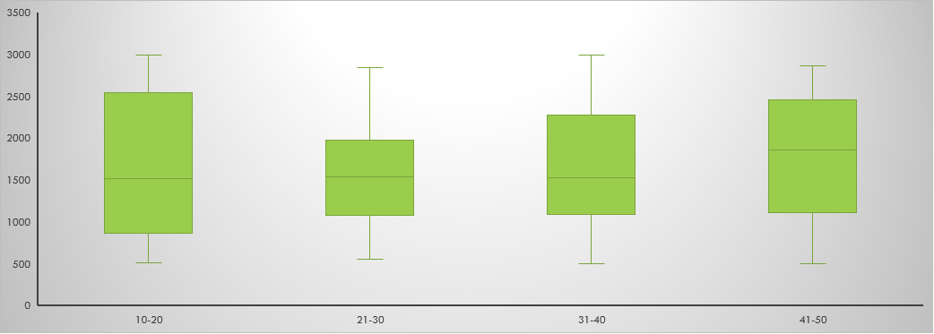
Monthly entertainment by age group

Slide 13
COUNT OF MOST PREFFERED PLATFORM

Slide 14
PREFERED PLATFORM BY AGE GROUP

Slide 15
Event Attendance Per-Year By The Age Group

Slide 16
Data Analysis & Interpretation
The 30-39 and 40–50 age groups spend the most on entertainment per month.
Horror and Fantasy are the most preferred genres across all age groups.
Users who spend more time streaming tend to have higher entertainment expenses.

Slide 17
Conclusion
The project successfully analyzes entertainment behavior across multiple demographics and identifies strong correlations between age, streaming habits, and spending. Excel proved to be an effective tool for quick and visual data analysis. The results can guide entertainment platforms in understanding user preferences and improving content delivery strategies.

Slide 18
Thank you

Slide 19
Count of Preferred_Platform | Column Labels
Row Labels | Amazon Prime | Disney+ | Hotstar | Netflix | Sony Liv | Zee5 | Grand Total
Female | 18 | 29 | 30 | 13 | 20 | 20 | 130
Male | 16 | 17 | 19 | 16 | 25 | 27 | 120
Grand Total | 34 | 46 | 49 | 29 | 45 | 47 | 250

